Slide 1

Airbnb: Politics and Culture of Home Sharing
Leanna Wolfe, PhD
April 1, 2016
Society for Applied Anthropology
Vancouver, Canada

Slide 2
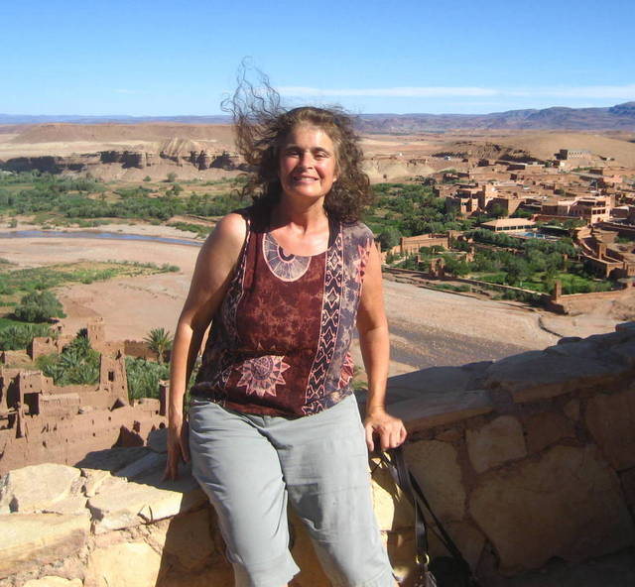
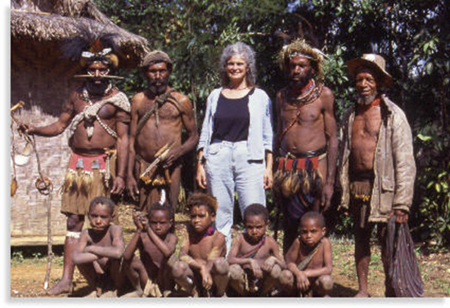


About Dr. Leanna Wolfe
MA Anthropology, New School for Social Research
PHD Sexology, Institute for Advanced Study of Human Sexuality
Writer, Photographer, World Traveler
Airbnb Host beginning 2010
Lives in Los Angeles, California
Professor at Los Angeles Valley College
Dr. Leanna Research and Consulting

Slide 3
An Anthropological Perspective: Examine Interests and Goals of Players
  Airbnb Leadership and Staff
  Hosts
    On Premises Home Sharers
    Off Site Owners of One or Two Properties
    Managers of Multi-Unit Properties
  Guests
    Family/Friends of Locals
    International Tourists
    Adventure Seekers
    Business Travelers
  Local Communities
    Protect status quo for Hotel Operations
    Preserve Rental Housing for Residents
    Respect for Neighbors and Neighborhoods

Slide 4
Cultural History of Home Sharing
Sharing Housing and Food with Travelers/Boarders
  Medieval Europe and Colonial America
    Owning a home was owning a business
    Boarders might Share a Bed with the Home Owner
      No Heating!
Long Cultural History
  Reason for Exogamous Marriages
    Papua New Guinea
    Aboriginal Australia

Slide 5
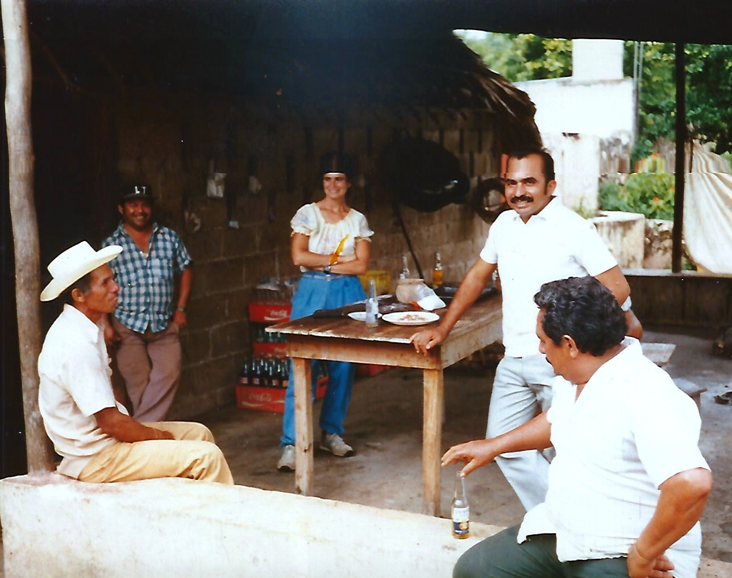
My Personal History
As a young anthropologist in Mani, Yucatan

Slide 6
Informal Exchange
Mani, Yucatan, Mexico
  15 pesos/day for room and board
    1975 ($1.20/day)
    Hammock in shared room with host family
Nairobi, Kenya
  Research on Polygamy
    Hosts enabled community access
    Gifts and more gifts
Couch Surfing
  Gifts, Friendship and Adventure

Slide 7
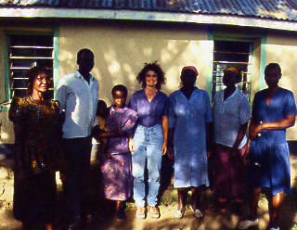
Field work amongst the Luo on Rusinga Island, Kenya

Slide 8
Field work amongst the Huli in Tari, Papua New Guinea

Slide 9
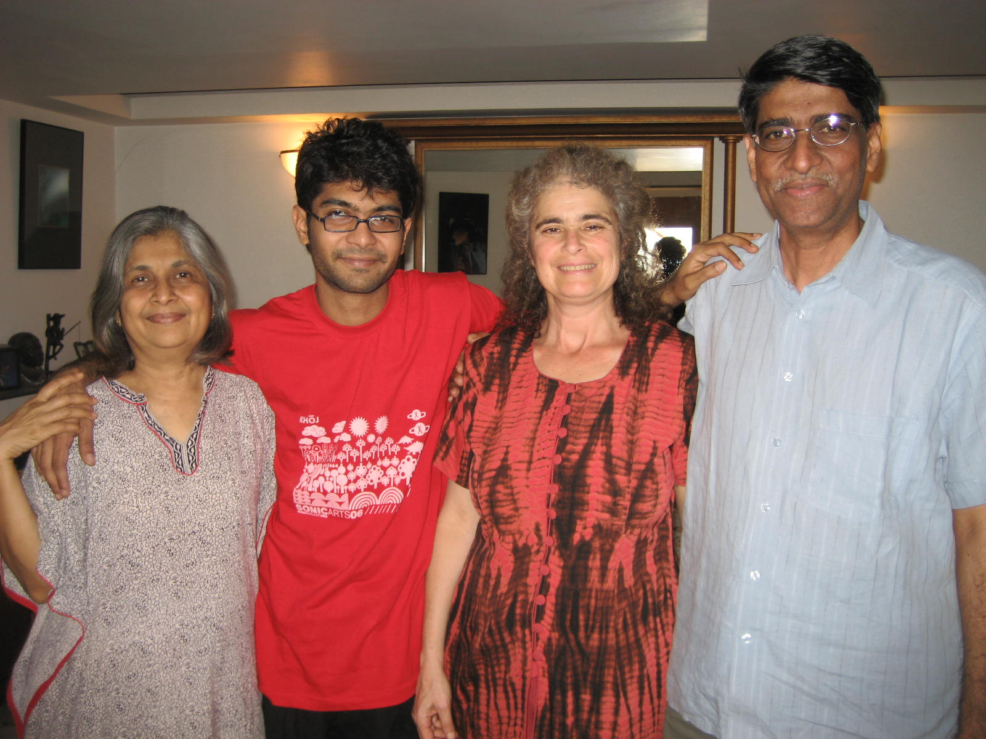
Home Stay in Mumbai, India

Slide 10
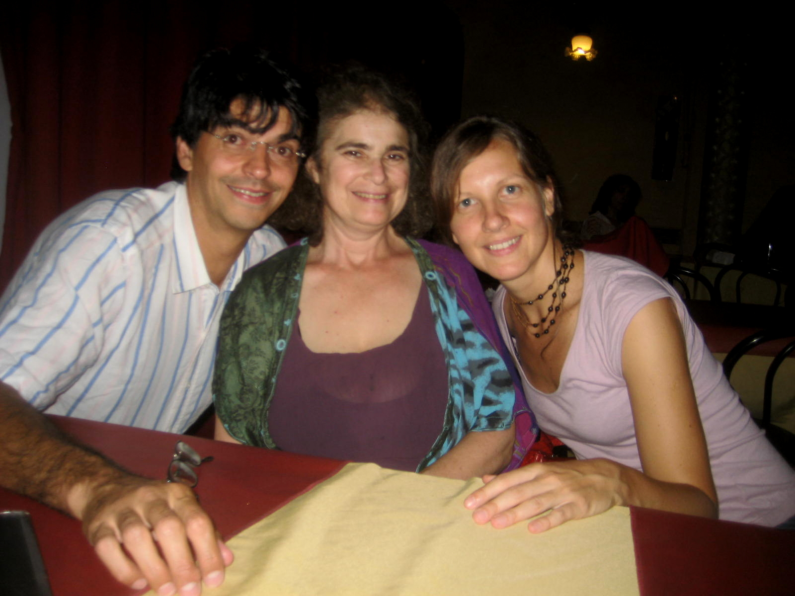
With Couchsurfing Hosts in Buenos Aires, Argentina

Slide 11
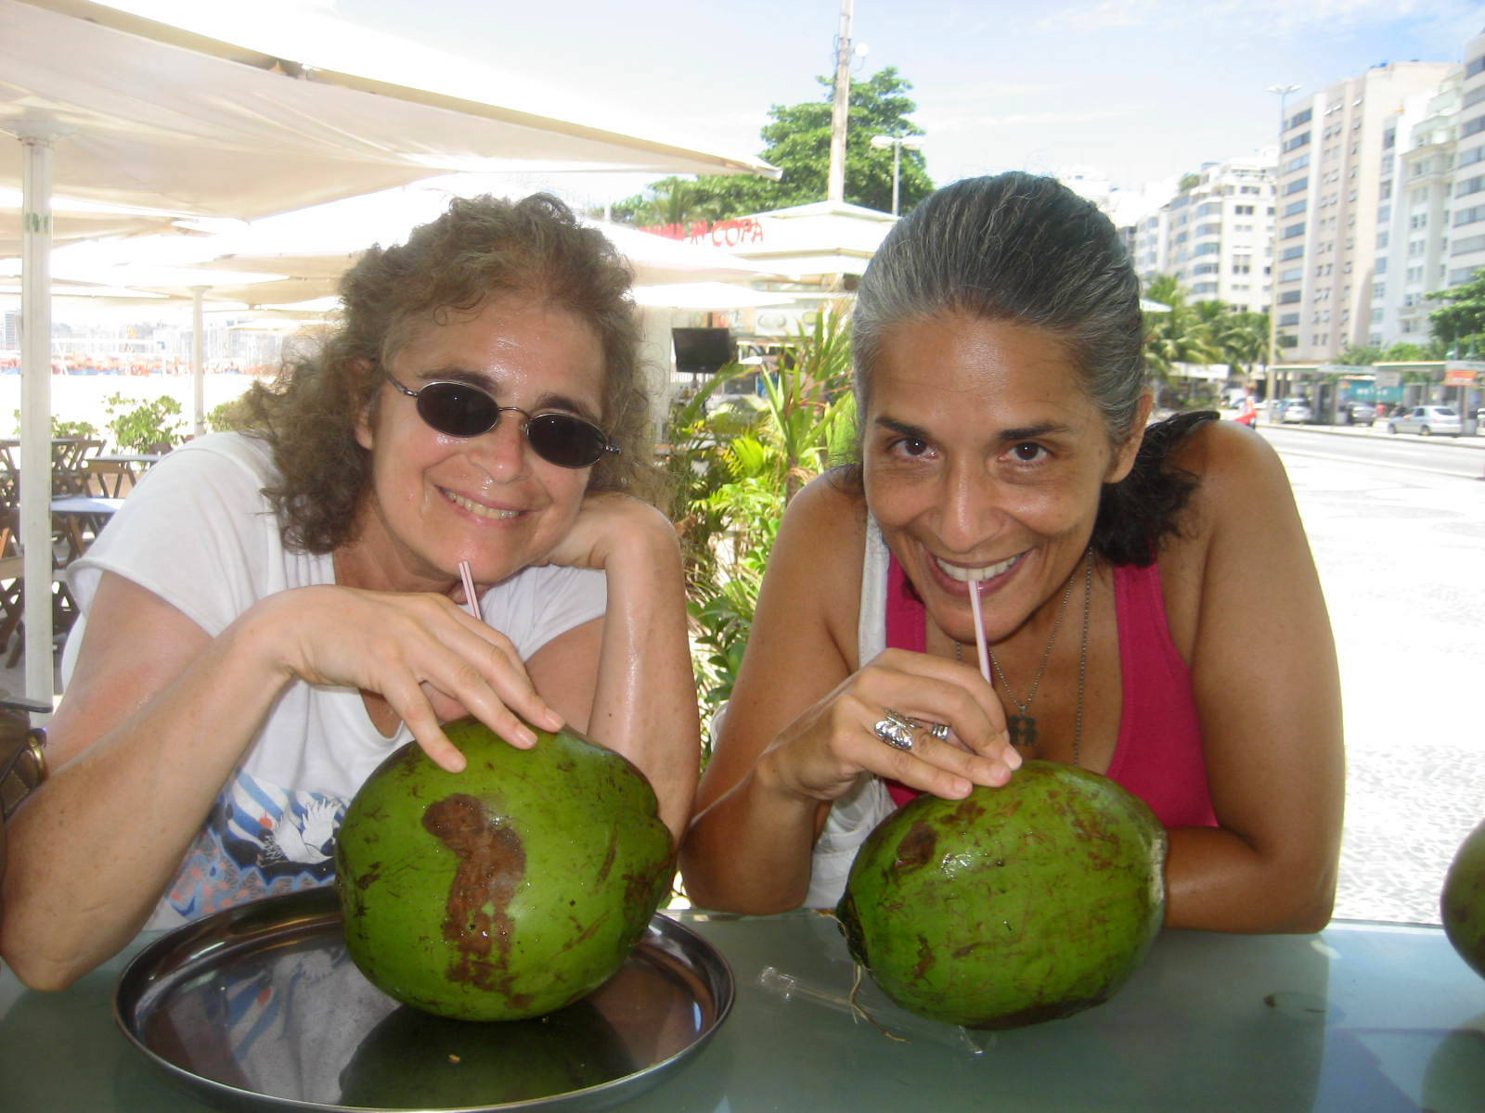
Sipping Coconuts with Couch Surfing host in Rio de Janeiro

Slide 12
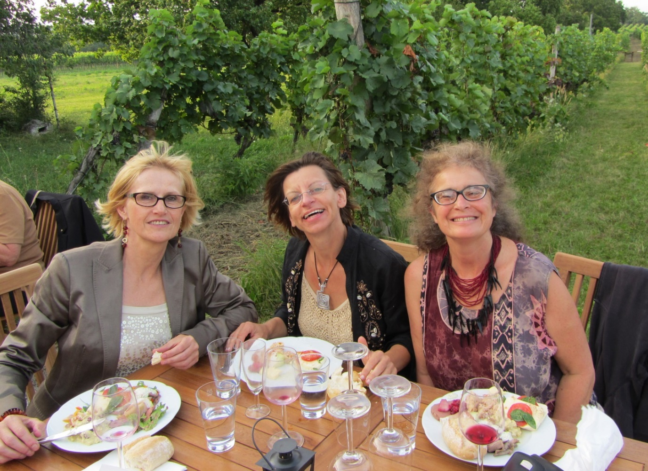
Wine tasting with Couch Surfing Hosts in Vienna

Slide 13
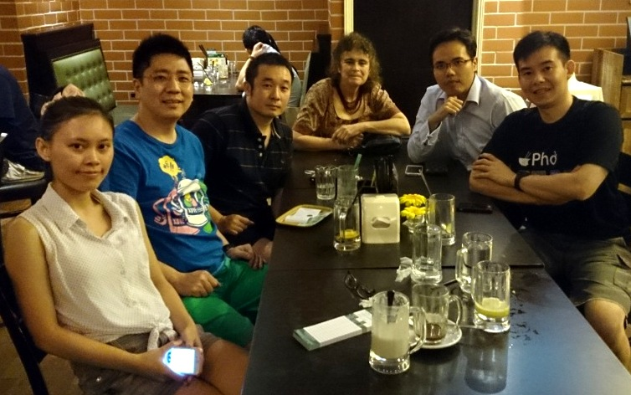
With Couch Surfing Host and his friends in Kuala Lumpur

Slide 14
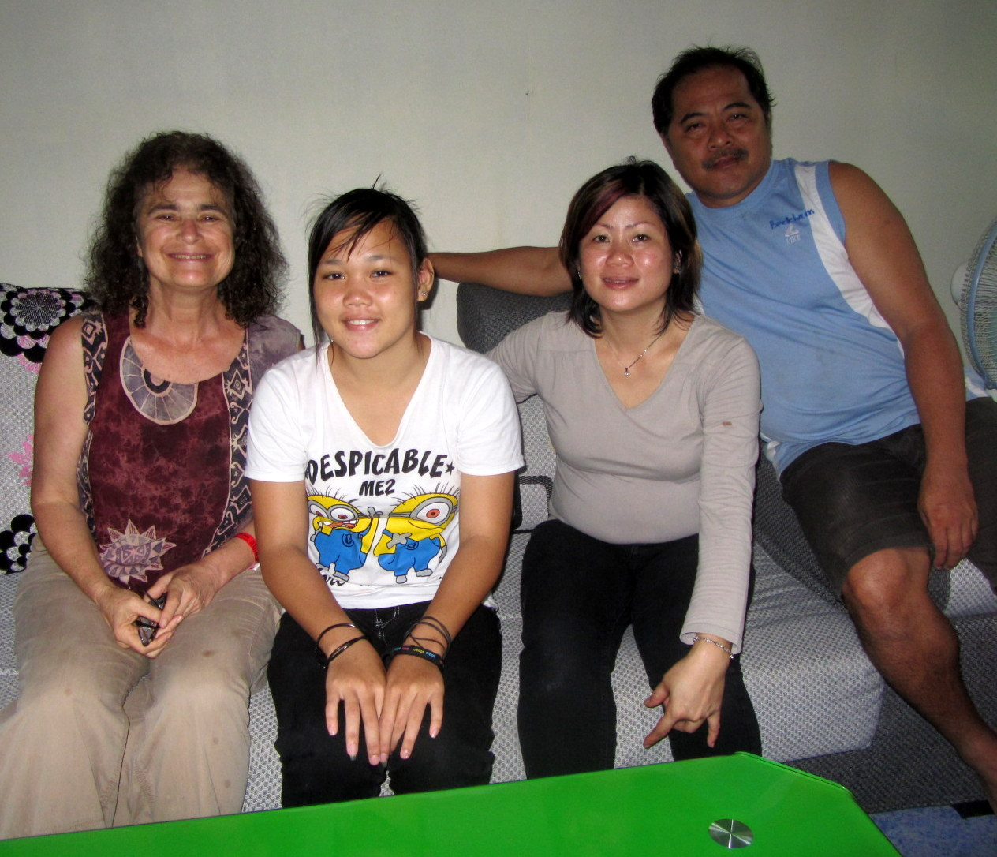
With Home Stay Host Family in Mulu, Borneo

Slide 15
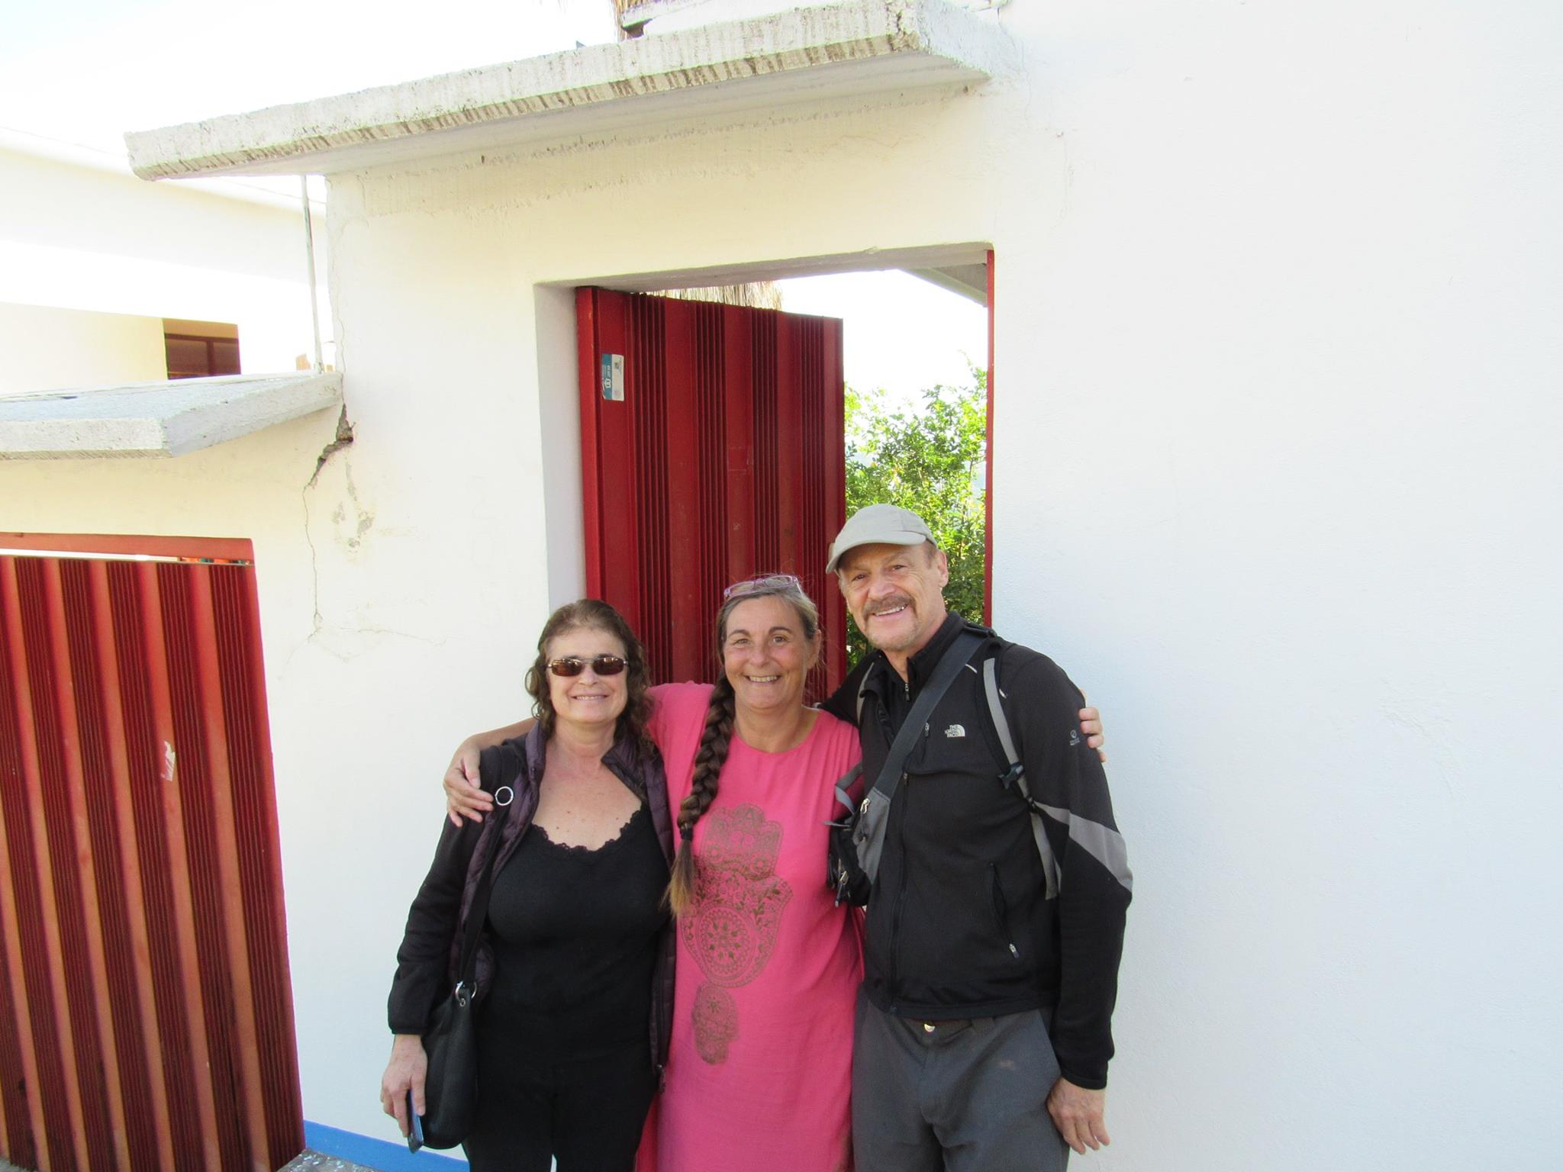
With Airbnb Host/Anthropologist in Oaxaca, Mexico

Slide 16
Airbnb’s Beginnings
2008 launch
  Founders Promote an Airbed stay in their SF Guest Room
  Homestays for Special Events
    South by Southwest
  Four “Launches”
  NYC
    Alternative to Manhattan’s Pricey Hotels
  Photos
  Detailed Descriptions

Slide 17

Airbnb’s Founders
Airbnb Open – Paris, France November 2015

Slide 18
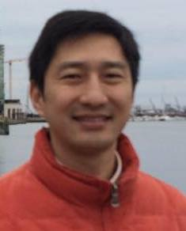
My Early History with Airbnb
July 2010 Purchased a Home in Los Angeles
  Hosted first guest in September
Cross-Promotions through Craigslist
Luning Sun – Chinese Doctor arrives in November
  Special rate for a living room couch
    Life long friends
    First of many Chinese Guests

Slide 19
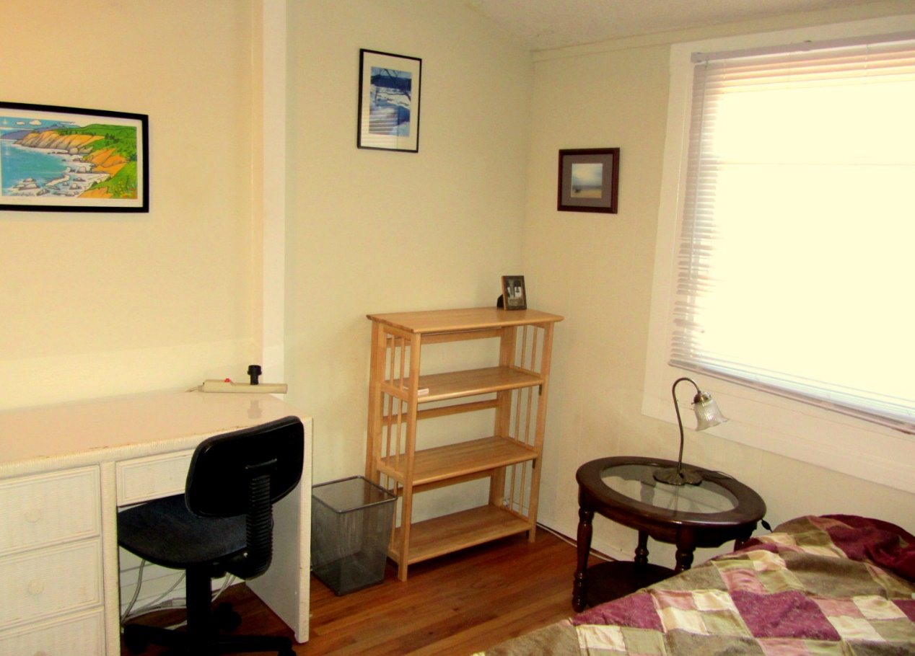
Guest Room Photography

Slide 20
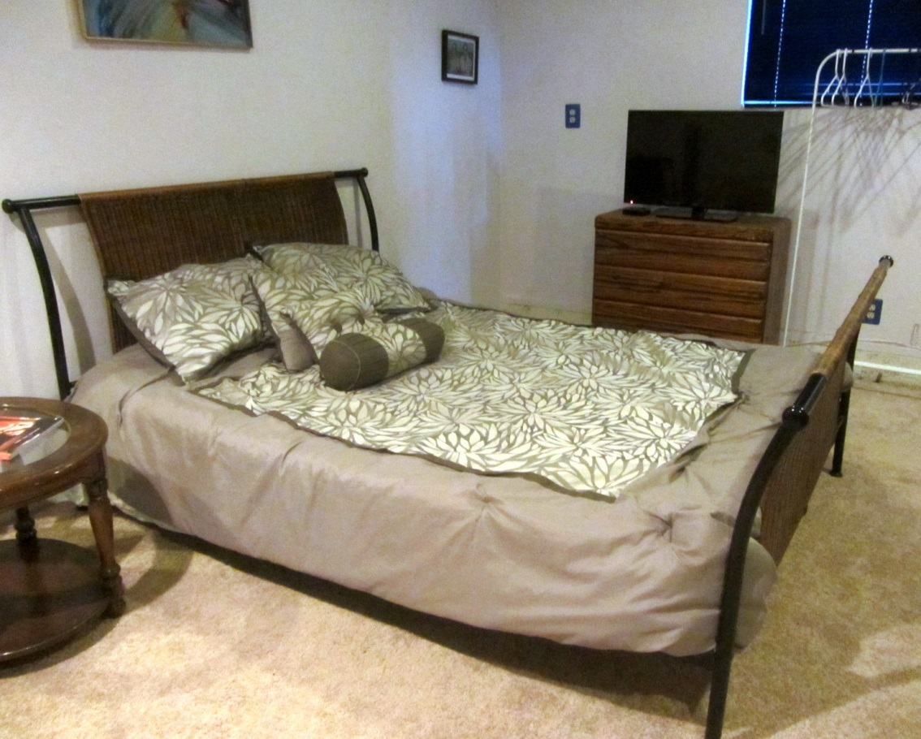
Garage Converted to a
Spacious Guest Room! spacGuest Room

Slide 21
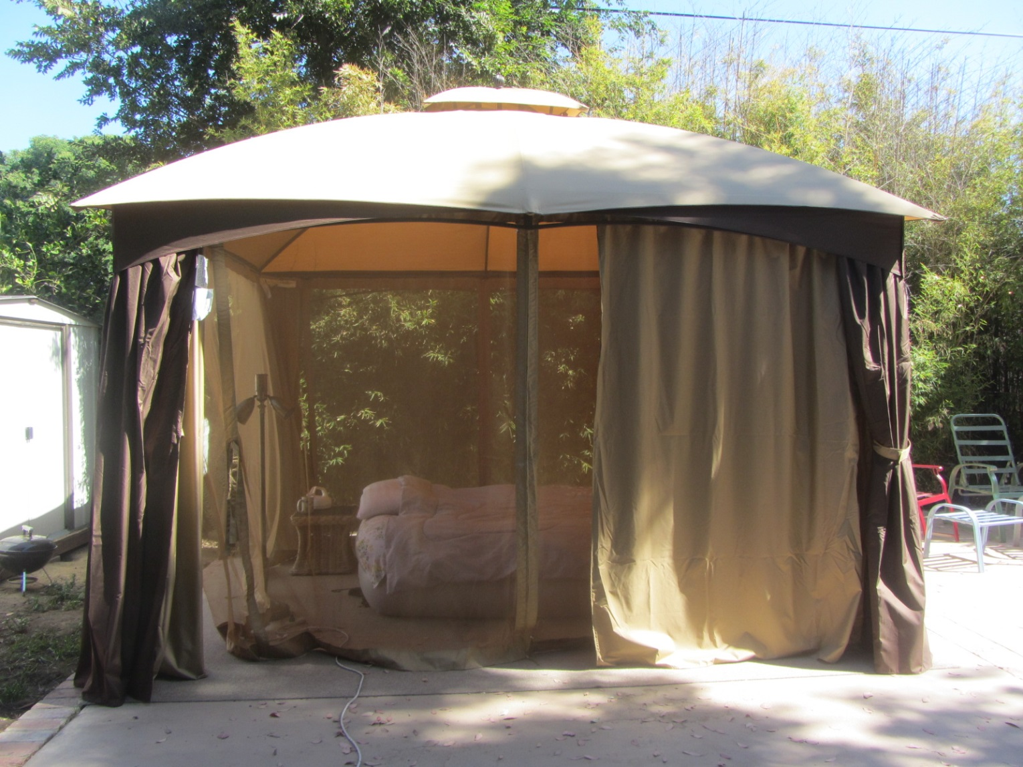
Glamping in a Beautiful Yard!

Slide 22
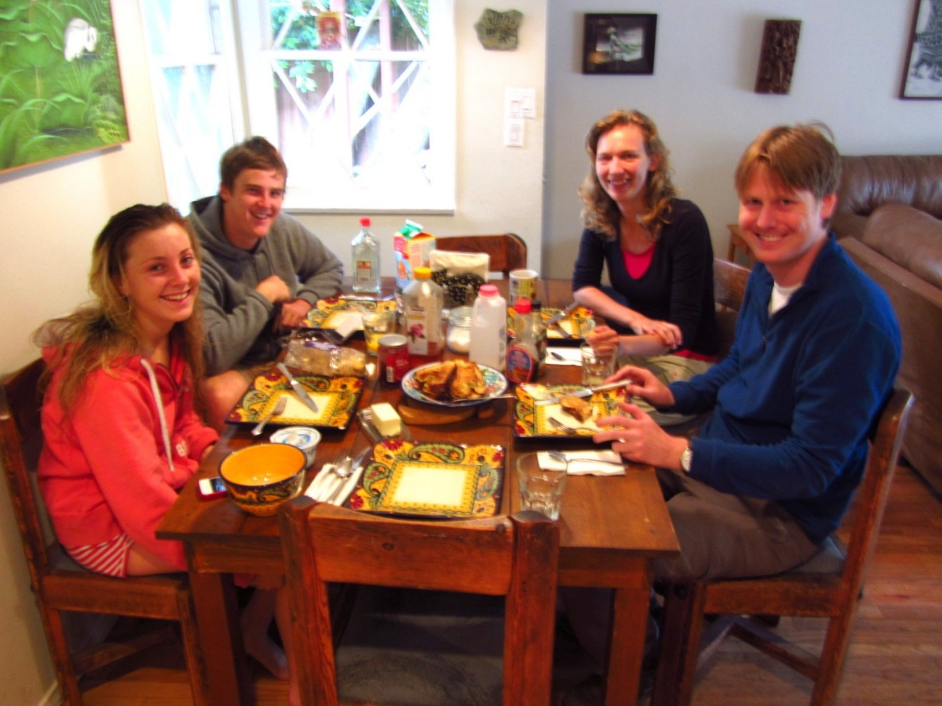
French Toast Breakfast for Summer European Guests

Slide 23

Italian Guests Enjoy the Backyard Hot tub

Slide 24

Elena Arrives from Siberia

Slide 25
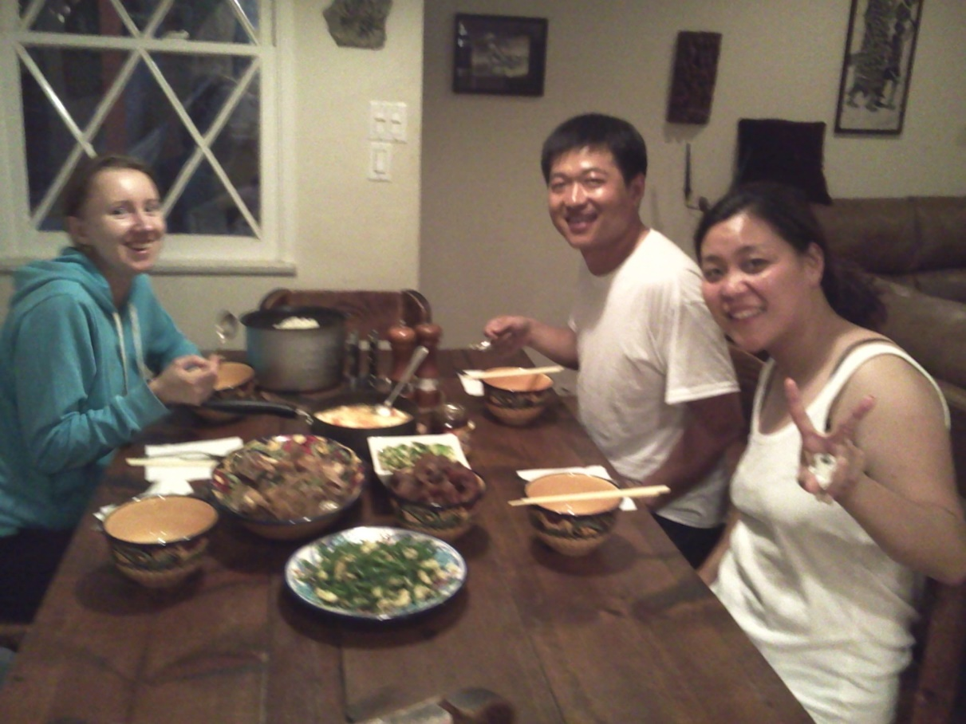
Elena with Koon and Jiao (friends of Luning)

Slide 26
The Culture of Home Sharing:
Share Living Quarters with On-Premises Host(s)
  Potentially Share
    Kitchen
    Bathroom
    Living Room
    Laundry
  Potentially Interact With
    Host(s)
    Roommates
    Other Guests
    Pets
    Children

Slide 27
Engage the Hosts’ World
Access Another World …Without Owning it…
Shop at Local Markets
Cook at Home
Visit Local Cafes and Restaurants
  Unique Host Guidebooks
Hosts’ Friends and Pets
  Inside Access to a local’s world
    Unexpected Invitations & Opportunities
    Beyond and Apart from Touristic Sites

Slide 28
How Airbnb is Unique
An Airbnb Home Stay
  Possibility of Socializing with Host(s)
  Host is Paid
  Telephone Concierge Service
Not Couchsurfing
  Expectation of Socializing with Host(s)
  Expectation of Gift from Guest
  Sleeping Surface often a Living Room Couch
Not a Hotel
  Guests can be noisy
  Guests can leave a mess
  In Person Front Desk Service

Slide 29
Airbnb Becomes a Game Changer
Direct Payment
  Not just a gift/friendship offering
  Paid in Advance
Internet Explosion
  Partnership between Boomer’s with Property and Millennials with Web Design Skills
24/7 Customer Service (by telephone)
Online References/Reviews
Insurance to Protect Hosts and Travelers

Slide 30
Partnership with Hosts
Focus on Hosts
  Unlike Couch Surfing and Servas which network Travelers
Conferences, Newsletters, Social Networking
Shared Interests in Making Money
Incentives for Hosts to Improve
  Ratings for Communication, Cleanliness, Friendliness
  Super Host Status
Hosts Organized for Political Action
  Airbnb Hires Community Organizers
  Influence Municipal Government Regulations

Slide 31
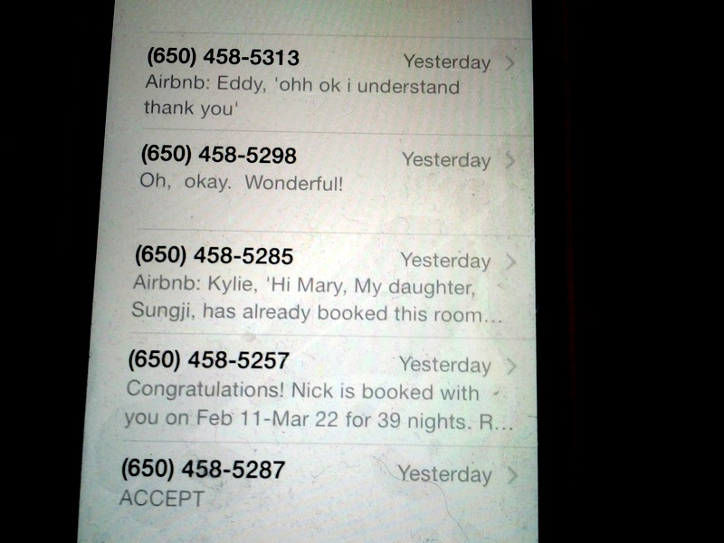
Hosting as a Career

Slide 32
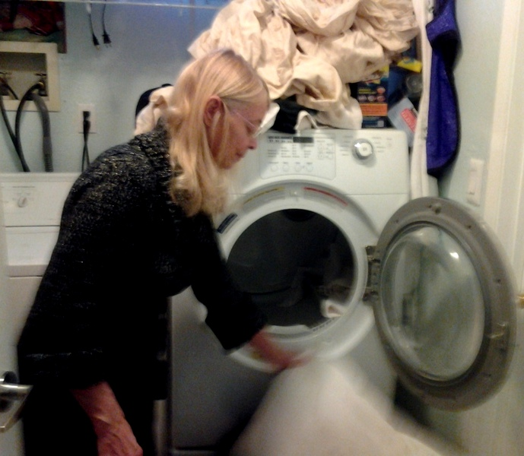
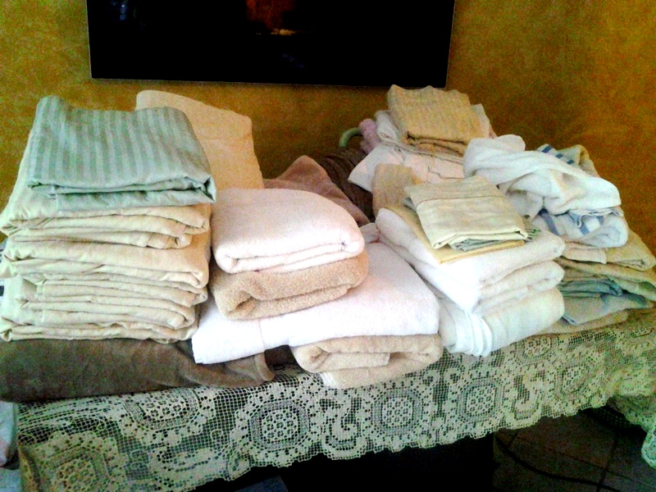
Busy Host Mary Does Lots of Laundry

Slide 33
Ancillary Services for Busy/Professional Hosts
Housekeeping
Laundry
Key Exchange
Food Delivery
Local Tours
Website Management
Ride Sharing

Slide 34
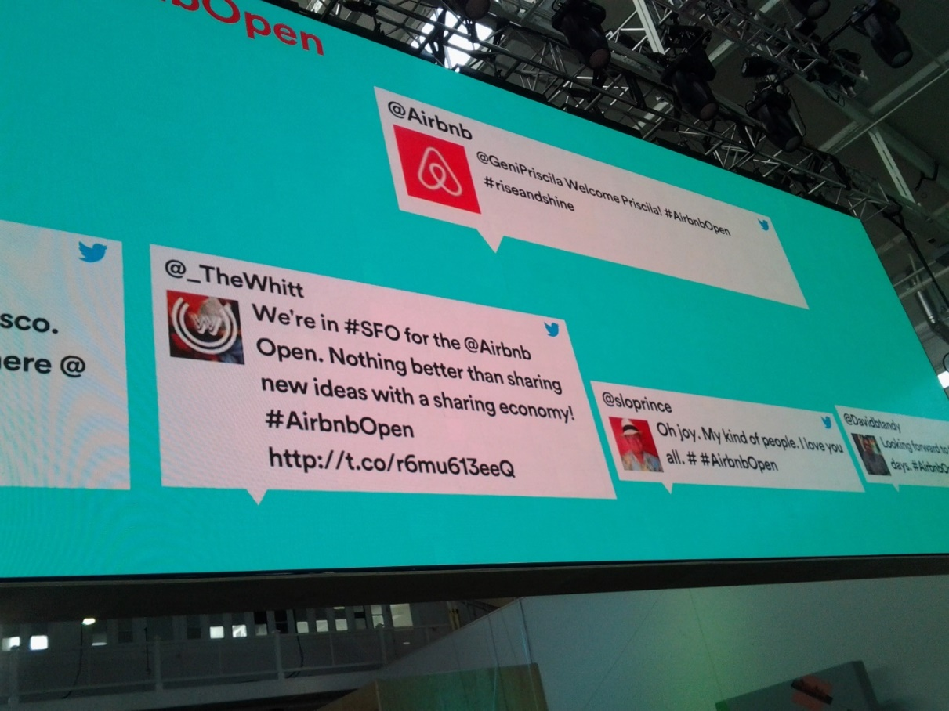
Airbnb Open – November 2014 International Host Conference

Slide 35
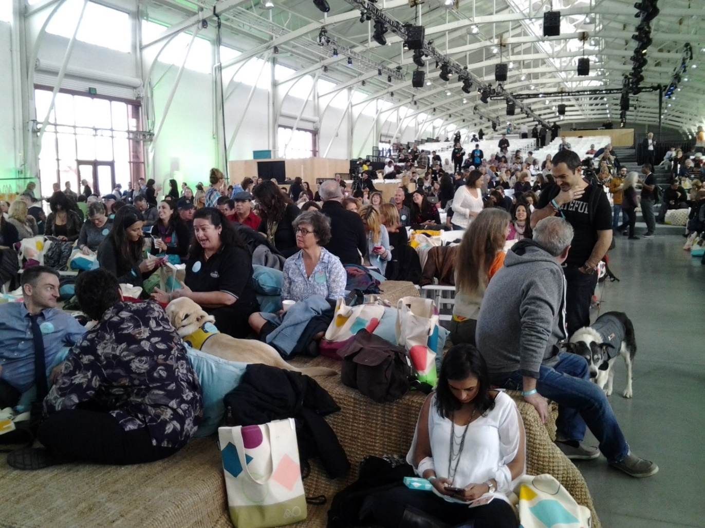
1500 Hosts from Around the World Meet in San Francisco

Slide 36
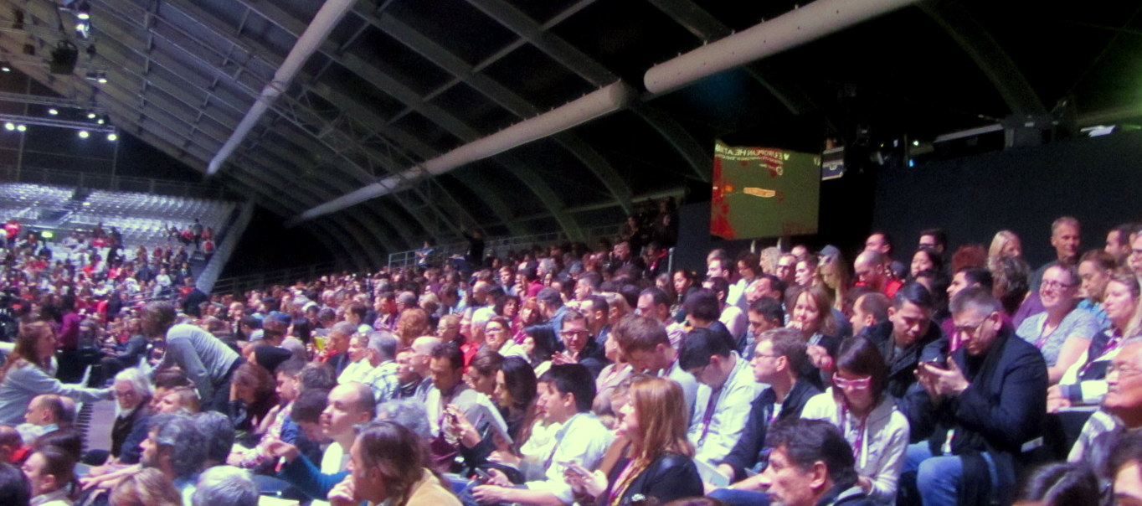
And 6000 Hosts meet in Paris…

Slide 37

Cirque de Soleil Performs…

Slide 38
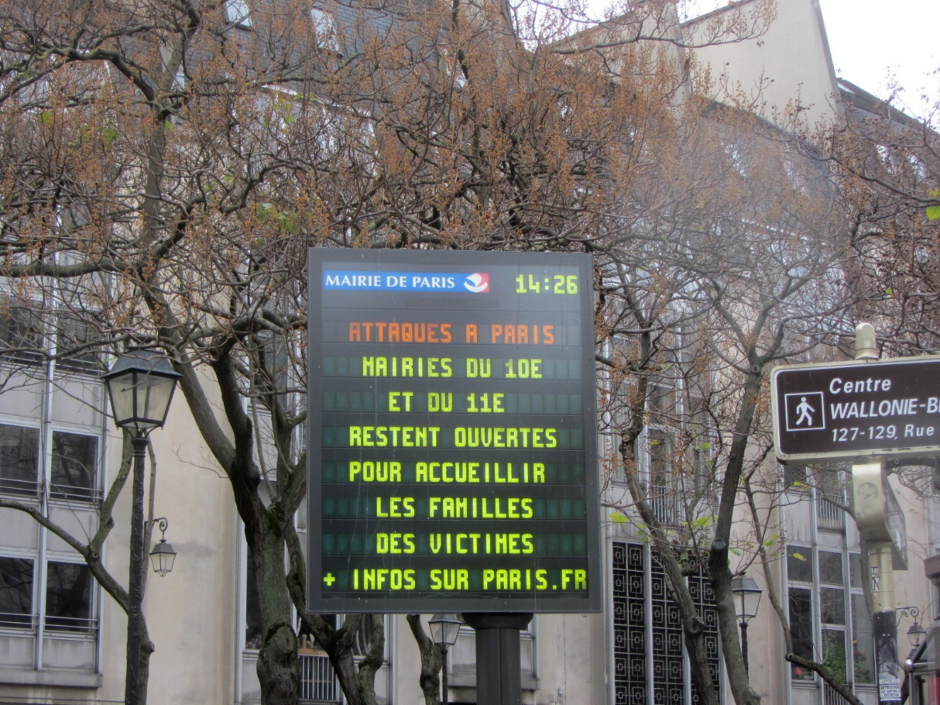
Conference Abruptly Ends Following Paris Bombings

Slide 39

Airbnb’s Players
Chip Conley – Head of Global Hospitality and Strategy
Brian Chesky – Co Founder and CEO

Slide 40
Accusations
Disruption Integrity of Residential Neighborhoods
  Parking
  Noise
  Unsupervised Parties
Conversion of Apartment Buildings to Airbnb Units
  Destroys Apartment /Condo Safety & Community
  Loss of Housing Stock for Local Workers
  Major issue in touristic areas
    Asheville, NC
    Hawaii
    LA’s Beach Communities
Loss of Revenue for Hotels
Non-Payment of Transient Occupancy Tax

Slide 41
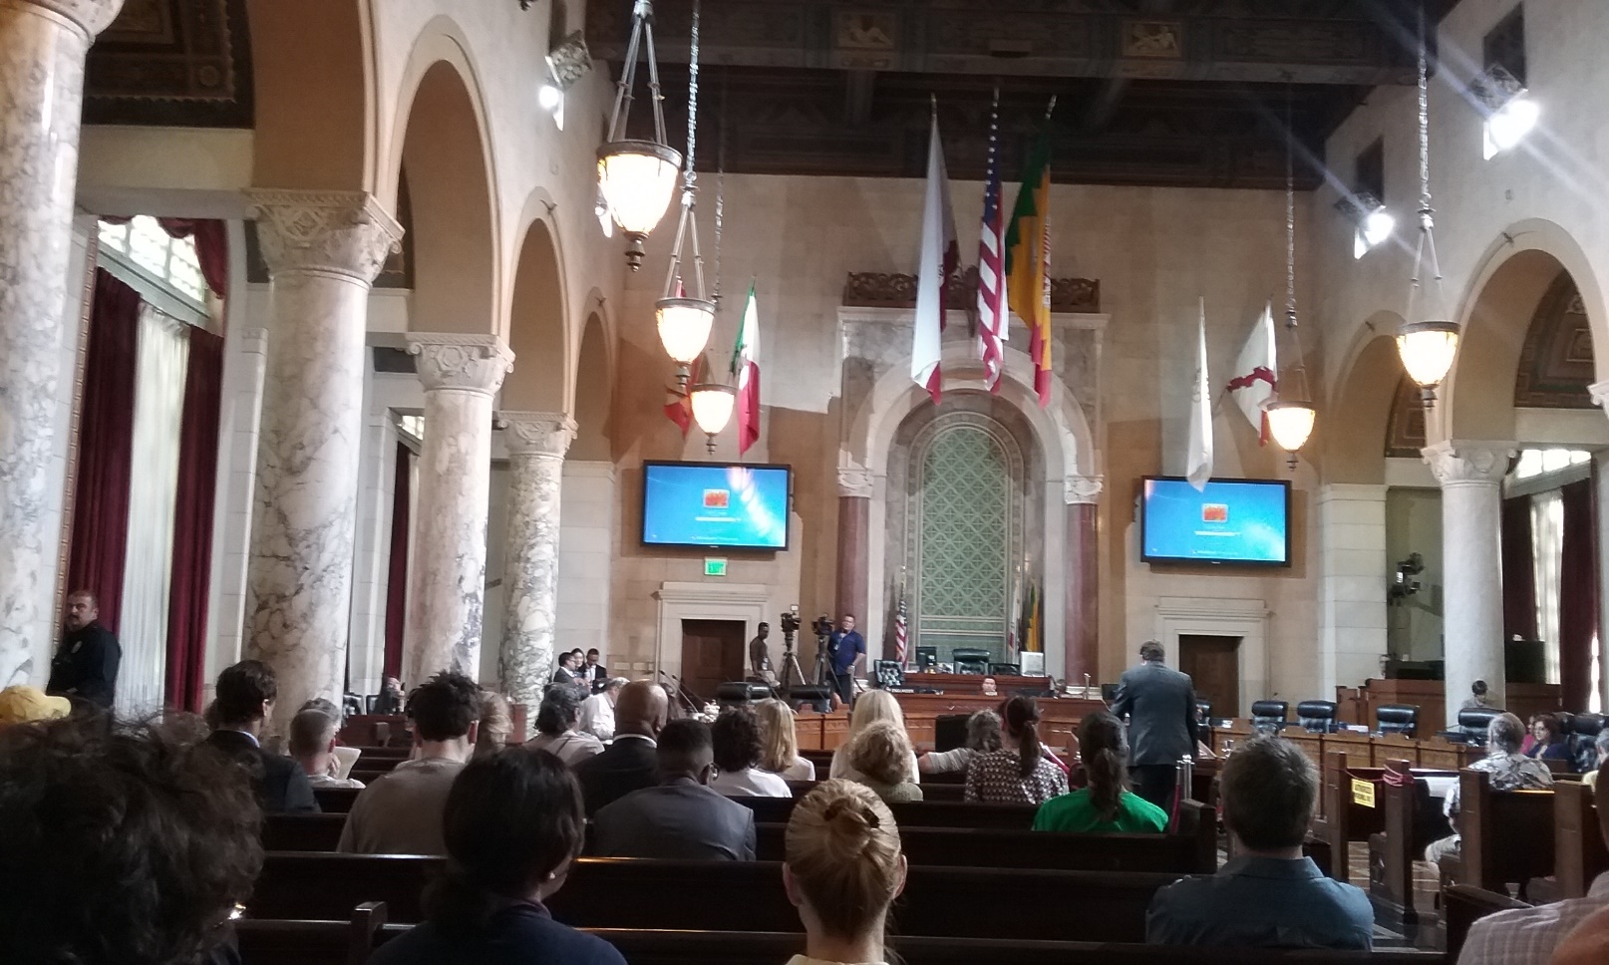
Los Angeles City Council Considers Home Sharing
Airbnb Hosts, Concerned Neighbors and Ancillary Businesses voice their opinions.

Slide 42
Normalize Home Sharing?
(My Quandary)
Home Stays are Unpredictable Adventures!
  Snuggled on a Reed Mat with a Tarascan Family
  In a Hammock with a Mayan Family
  In a Huli Women’s House in Papua New Guinea
A Fear-Based Cohort Seeks to:
  Legislate Safety and Security
  Ensure Consistency
  Impose Cleanliness Standards

Slide 43
Airbnb’s Counter-Attack
Make Cities more Affordable to Travelers
  Airbnb Travelers stay longer and ultimately spend more at neighborhood restaurants and markets than hotel guests
Enable Low-Income Home Owners to Afford their Homes
  82% of LA’s Hosts share only the home they live in
    Underemployed, Retired, Divorced
    Supplemental Income – Second Job
Promote Cultural Shift
  Community Organizers Hired
  Normalize Home Sharing
  Make “Strangers” into “Friends”

Slide 44
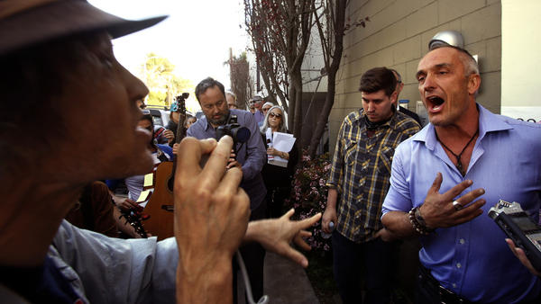
Strategies to Stay Afloat
Airbnb cuts ties with vacation-rental firms in Los Angeles
Mark Lipman, with People Organized for Westside Renewel, left, argues with Sebastian de Kleer, owner of Globe Homes and Condos, at a protest in Venice on Wednesday. The firm had many of its L.A. Airbnb listings removed this week. (Genaro Molina / Los Angeles Times)

Slide 45
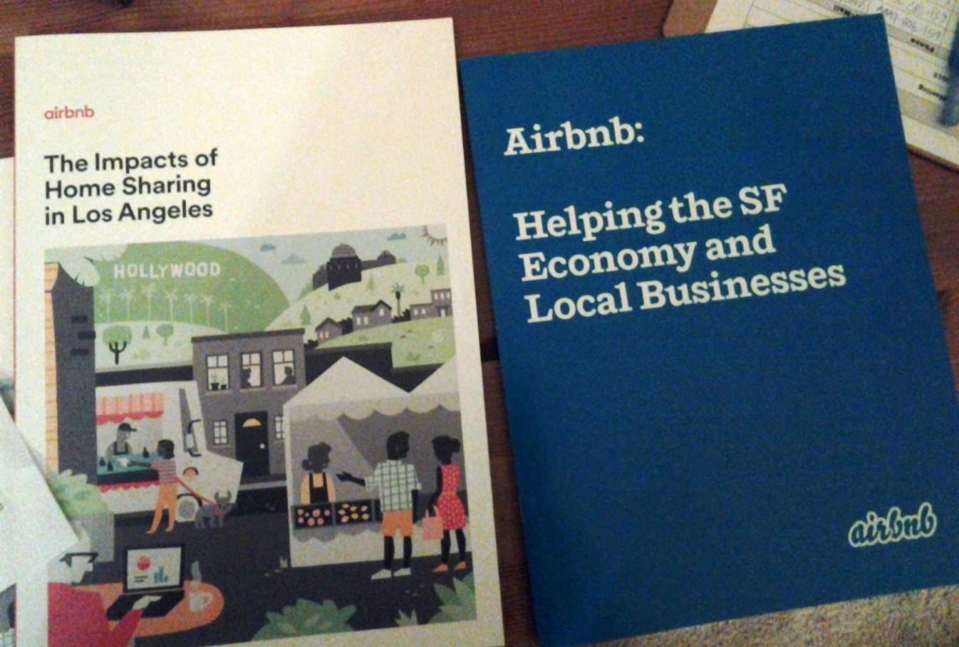
Airbnb Produces
Economic Analyses

Slide 46
Economic Impact of Airbnb in Los Angeles
Since its inception 500,000 guests have used Airbnb in Los Angeles
  250,000 in 2014
2014 Revenues Spent in LA Neighborhoods
  N. Hollywood 2 million dollars
  Sherman Oaks 1.3 million dollars
  Encino/ Van Nuys 500,000 dollars

Slide 47
LA’s Airbnb Home Sharing Guests
Budget Travelers
  Afford to Extend their Stays
  Family & Friend Visits
    Weddings, Celebrations, etc.
  Sleep in a Comfy Private Room
    Not Cars / Noisy Youth Hostels
Transitioners
  Relocating for work, etc.
Temporary Workers
  Pilot Season Actors
  Medical Personnel
  Film Industry Crew

Slide 48
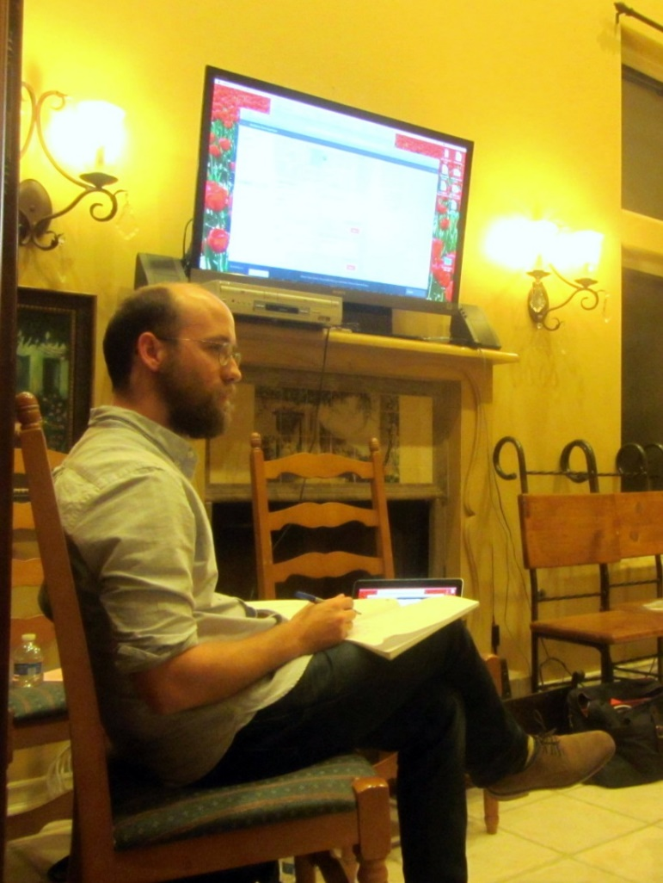
Airbnb Hires Community Organizers

Slide 49
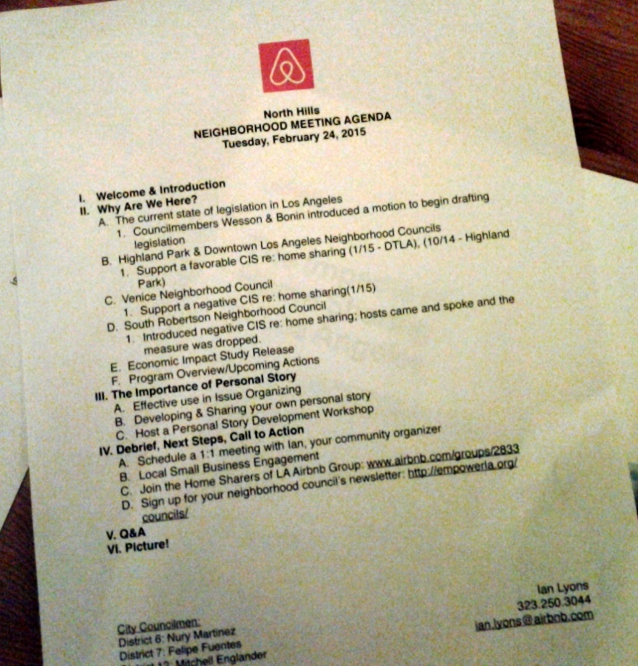
Agenda for a Host Organizing Meeting

Slide 50
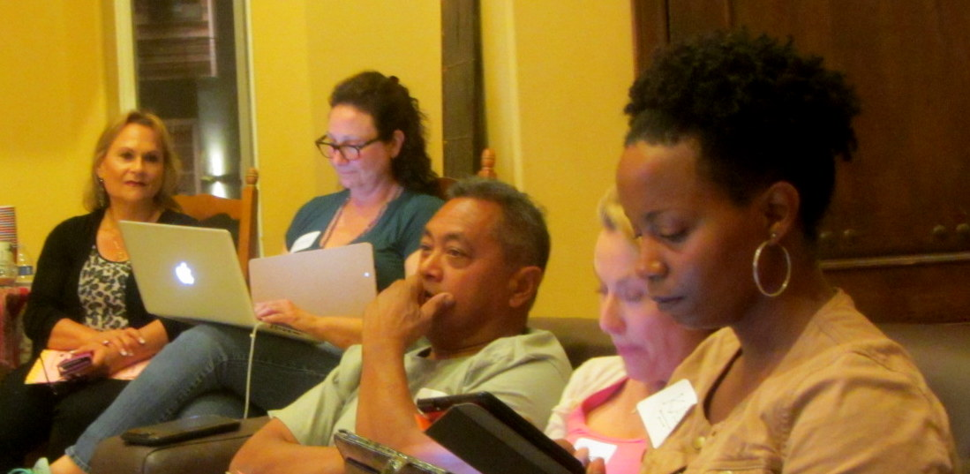
Personal Story Workshops
Hosts learn to tell persuasive stories to city governments
  Challenge (At risk for foreclosing on property)
  Choice (Became an Airbnb Host)
  Outcome (International Friendships, Prosperity)

Slide 51
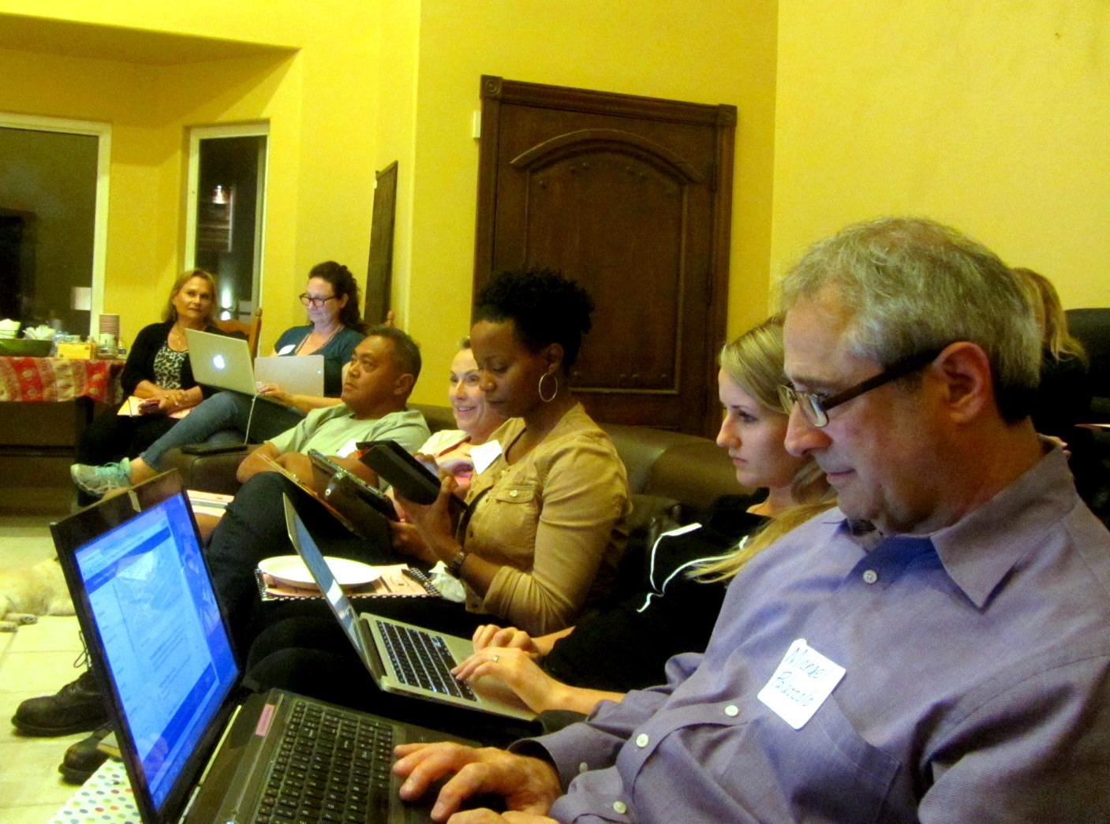
Host Training Workshop
Hosts learn how to create personal “guidebooks” for their communities

Slide 52
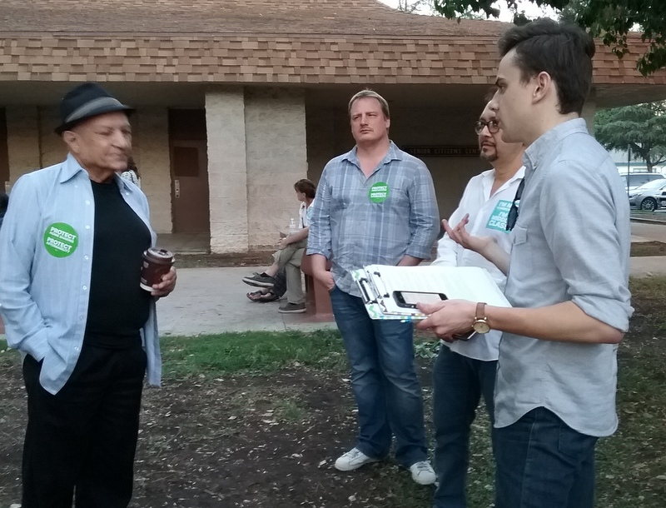
Host Reviews his Presentation with an Airbnb Organizer

Slide 53
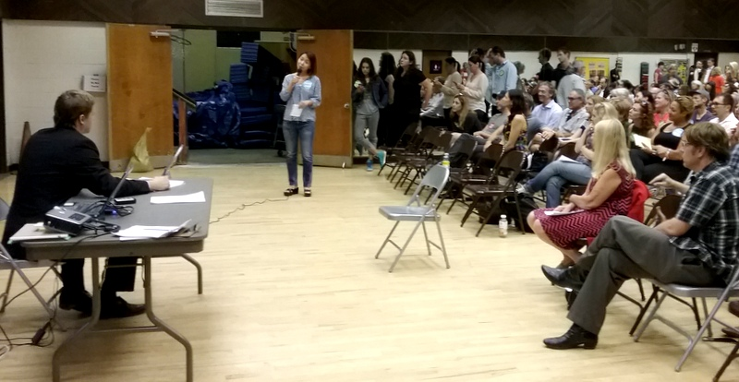
Host Presents Her Story to a Los Angeles Listening Session

Slide 54
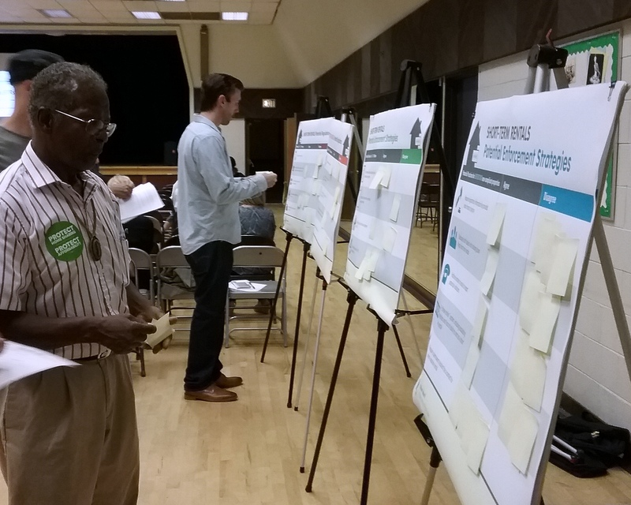
Listening Session Attendees Post Their Opinions

Slide 55
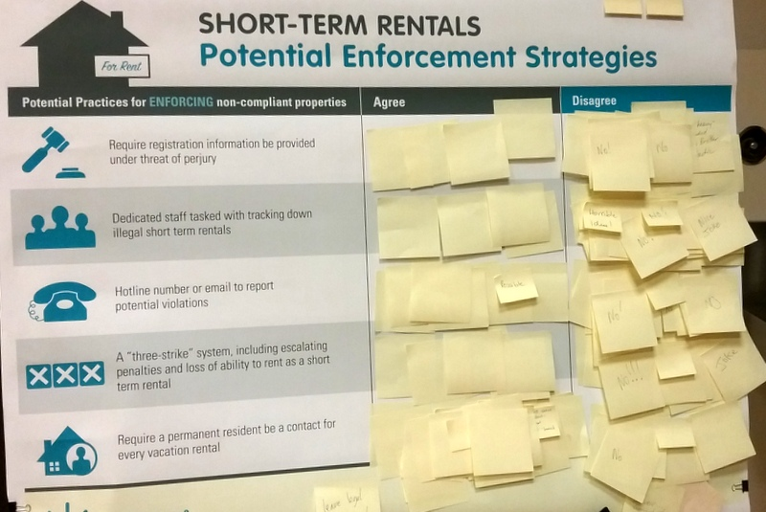
Opinion Boards

Slide 56
Hot Legislation
Santa Monica City Council
  Restricted Home Sharing
    Just in Private Home, Business License, Insurance, Tax
California State Bill 593
  Requires Hosting Platform to Report on Earnings
  Facilitate Collection of Occupancy Tax
    Invasion of fiscal privacy between hosts and site management

Slide 57
LA’s Quest for Common Ground
  Prevent Free-Market Economy of Short Term Rentals from Destroying Affordable Local Housing
    Regulate Numbers of Hosts in “Hot” Communities
  Local Needs for Sharing Economy Revenues
    Hosts on Fixed Incomes
  Promote Positive Business Tie-Ins
    Special Incentives for Guest/Visitors
  Short Term Rentals for Business Travelers
    Cheaper and Homier than a Hotel
  Alternative for Culturally Curious Travelers
    Access an Inside World!
  Assure that Hotels are Not Displaced
    Many travelers prefer the anonymity of a hotel
  Collect Transient Occupancy Tax in Booking Process

Slide 58
Is the Sharing Economy a Good Future?
An increasingly mobile world where access matters more than ownership
References/Reviews Readily Available
Response to a lackluster economy
  Housing Foreclosures
  Impermanent Employment
  Uber and Lyft Taxi-ish Services
  Vacation Car Rentals

Slide 59
A Global Village!
Sharing Economy via Airbnb
  Benefits Travelers
  Richens the Lives of Hosts
  Finding a Niche in Communities Worldwide
A Grand Shift in Consciousness
    Normalize Home Sharing
    Make Strangers into Friends
Anthropology’s Participant Observation Goes Global!

Slide 60

Dr. Leanna Wolfe
LeannaPhD@outlook.com
www.drleannawolfe.com
1-323-717-6167

